Slide 1
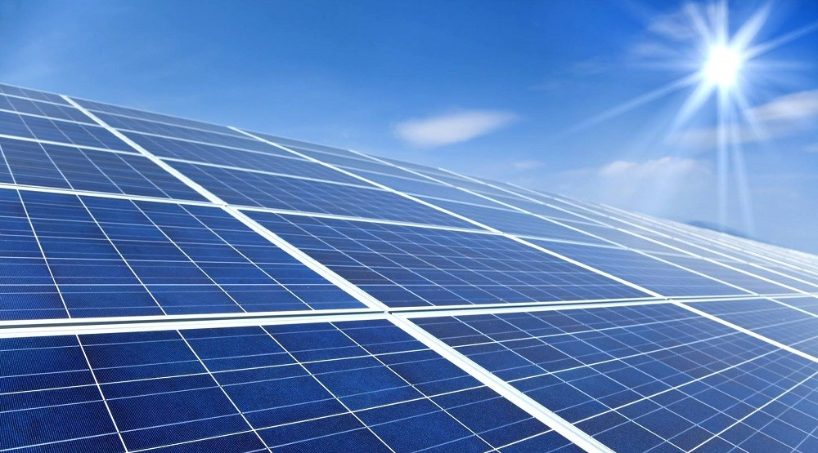
Solar Power Plant design
Lecture – 16 : Pvsyst

Slide 2
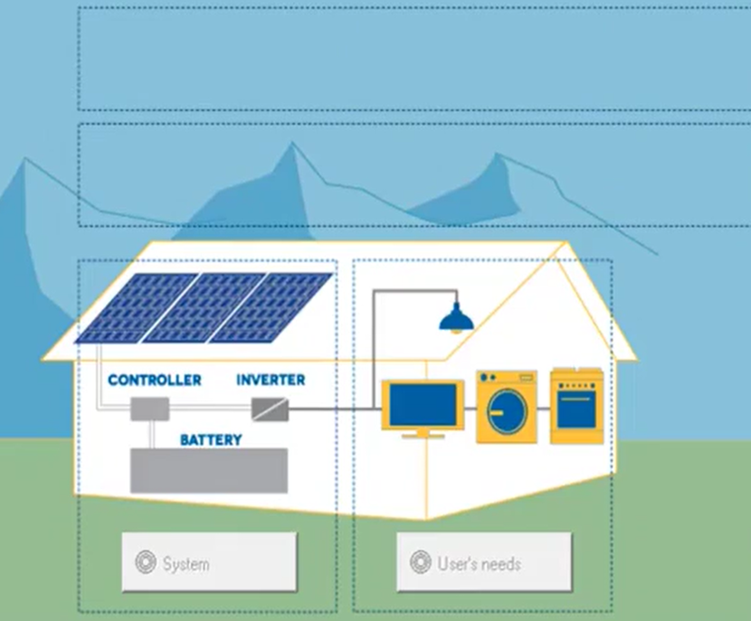

Slide 3
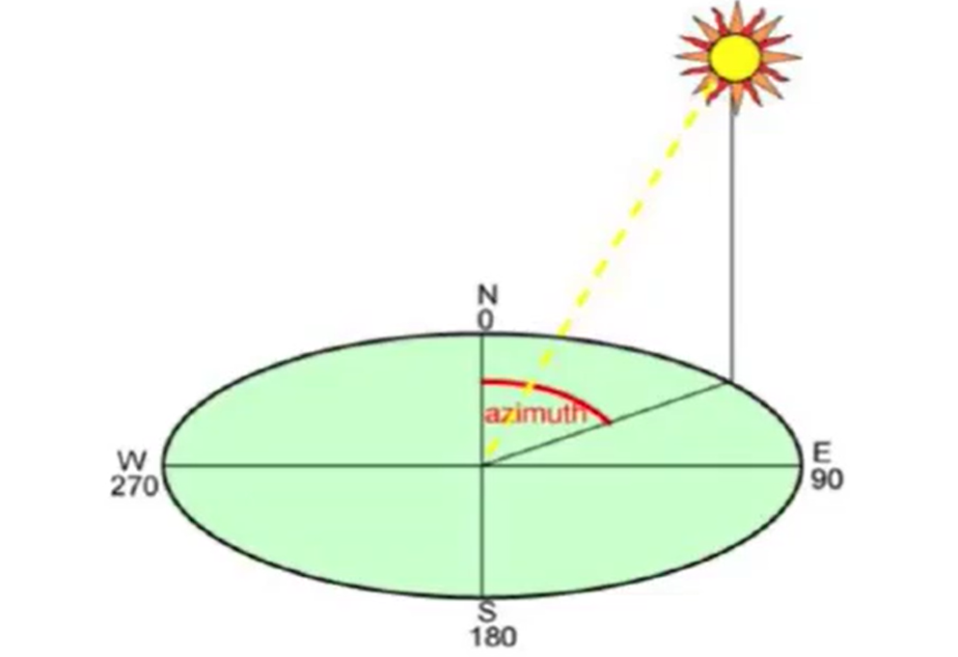

Slide 4
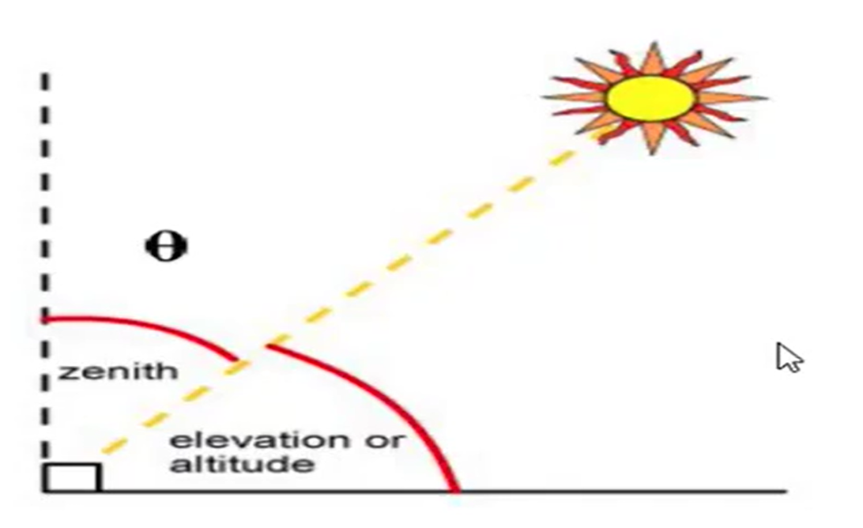

Slide 5
Thank you

